Slide 1
MATH 1010K Notes – Section 7.4
Linear Inequalities - Objectives
Graph an interval on a number line.
Solve a linear inequality using the addition and multiplication properties of inequality.
Solve an application that leads to a linear inequality.

Slide 2
Inequalities
Inequalities are algebraic expressions related by

Slide 3
Inequalities
We solve an inequality by finding all real number solutions for it. For example, the solution set of x > 3 includes all real numbers that are greater than 3.
We show the solution set of an inequality by graphing (see below). The set of numbers greater than 3 is an example of an interval.
(
3

Slide 4
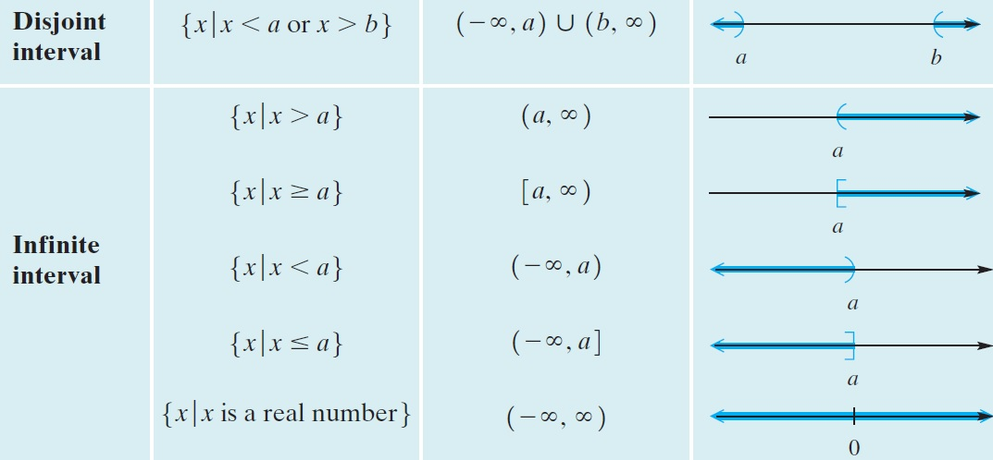
Sets and Interval Notation

Slide 5
Example: Interval Notation and Graphing
Write each inequality in interval notation and graph the interval.
Solution
(–1, ∞)
(–2, 4]
(
–1
(
]
–2
4

Slide 6
Example: Addition Property
Solve 3x + 4 > 2x – 1.
Solution
3x + 4 – 4 > 2x – 1 – 4
Subtract 4.
3x > 2x – 5
Combine like terms.
3x – 2x > 2x – 2x – 5
Subtract 2x.
x > –5
Combine like terms.

Slide 7
Multiplication Property of Inequality
Each side of an inequality may be multiplied by the same positive number without changing the solutions.
If the multiplier is negative, we must reverse the direction of the inequality symbol.

Slide 8
Example: Multiplication Property
Solve the inequality 4x < 12 and graph the solution set.
Solution
(
3

Slide 9
Example: Multiplication Property
Solve the inequality and graph the solution set.
Solution
Note that the symbol was reversed.
[
–4

Slide 10
Linear Inequalities – similar to Equations
The general process for solving linear inequalities is nearly identical as to solving equations:
Combine Like Terms
Look to Undo Parentheses (Distributive Propterty – multiply). Then try Step 1.
Get variables on the left side of equation. Use add or subtract to do this, if necessary. Then try Step 1. “Letters Go LEFT.”
Numbers go to right side of equation. Use add or subtract to do this, if necessary. Then try Step 1. “Numbers Go RIGHT.”
Undo multiply with divide (or undo divide with multiply) – except if you multiply or divide with a NEGATIVE number, be sure to REVERSE the direction of the inequality!

Slide 11
Example: Solving a Linear Inequality
Solve 3(2x + 4) < 2(x + 3) – 4.
Solution
6x + 12 < 2x + 6 – 4
6x + 12 < 2x + 2
4x < –10
(
-5/2

Slide 12
Applications
Below are some common phrases involving inequalities and their translations.
Phrase | Inequality
Is greater than
Is less than
Is at least
Is at most

Slide 13
Application
Max has test grades of 77, 84, and 86. If he wants an average of at least 80 after his fourth test, what are the possible scores he can make on his fourth test?
Solution
Step 1 We are looking for a range of scores that Max can make to achieve an average of at least 80.
Step 2 Let x = Max’s fourth test score

Slide 14
Application – Solution (continued)
Step 3
Step 4
Step 5 He must score 73 or more to have an average of at least 80.
Step 6 The average of 77, 84, 86, and 73 is 80.

